Slide 1
Croco2d Game Engine
github: https://github.com/alex-zhang/Croco-2DGameEngine
Alex Zhang

Slide 2
Before We Start

Slide 3
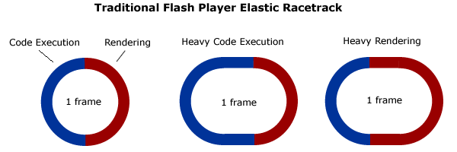
Flash Player Elastic Racetrack：
最早由Ted Patrick提出， 已得到官方的认可
http://tedpatrick.com/2005/07/19/flash-player-mental-model-the-elastic-racetrack/
Note： No ActionScript on the stack when rendering is in progress except BitmapData.draw, but rendering doesn’t call back to AS and AS waits the renderer to complete the operation

Slide 4
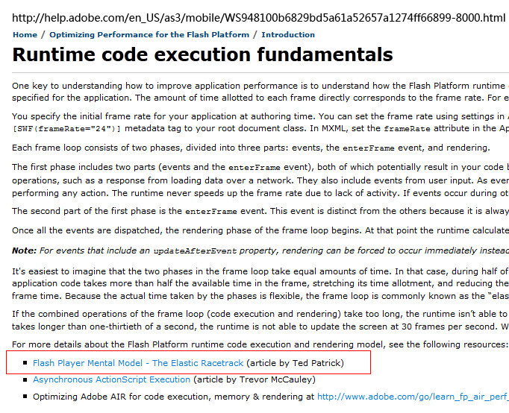
Flash Player Elastic Racetrack：

Slide 5
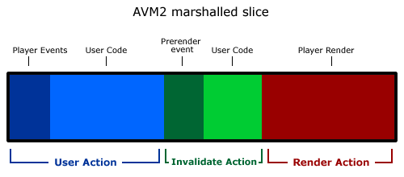
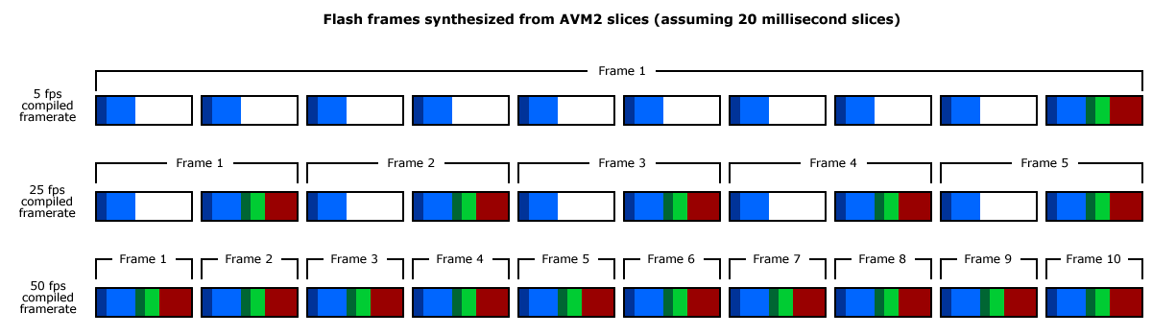
Flash Player Elastic Racetrack ： (Demo）
而Sean Christmann将这个理论进一步扩展成了“切片”模型
http://www.craftymind.com/2008/04/18/updated-elastic-racetrack-for-flash-9-and-avm2/
Demo: /可变跑道/...

Slide 6
Agenda
Stage3D-Starling
Entity-Component System
Croco2d Introduction

Slide 7
Starling
Principle.
Coordinate transformation.
Graphics rendering pipeline.
3D/2D Effect.
Starling-Framework code quick view.

Slide 8
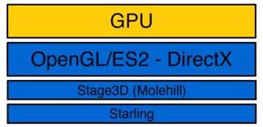
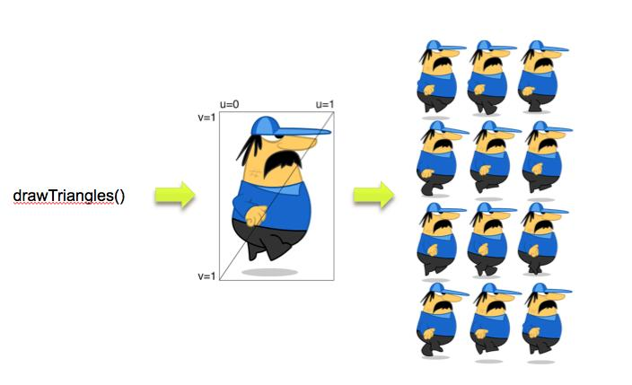
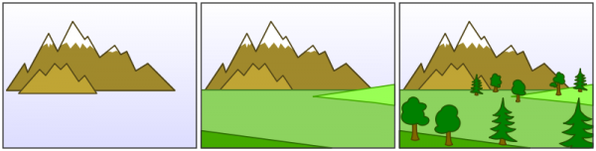
Starling-Principle

Slide 9
Starling – Coordinate Transform
Model Transformation.
link object coordinates to worldcoordinates.
…
3D Object
Container
Root Container
(3D Object)Matrix X (Parent)Matrix X …. = modelMatrix

Slide 10
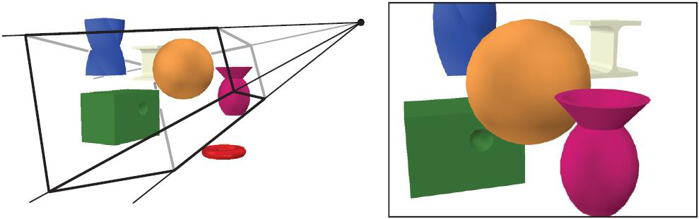
Starling – Coordinate Transform
View Transformation.
the eye/camera in worldcoordinates.
entire scene is transformed with the inverse view transform.
ModelMatrix X camera(eye)Matrix.inverse() = View(Screen)Matrix

Slide 11
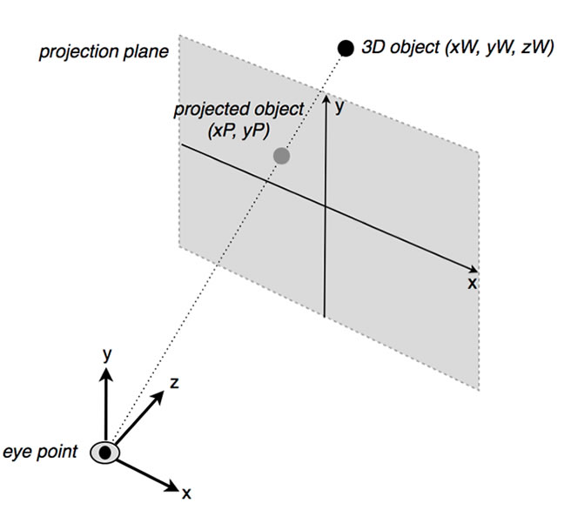
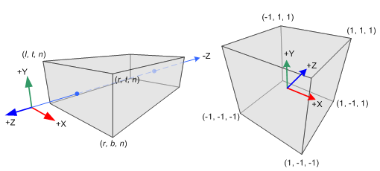
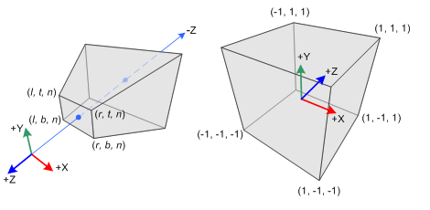
Starling – Coordinate Transform
Projection Transformation.
from view(screen) space to gpu space.
from n to (n-1) matrix transform algorithm.
finally the z range is between -1 and 1.
orthographic projection
Perspective projection

Slide 12
?

Slide 13
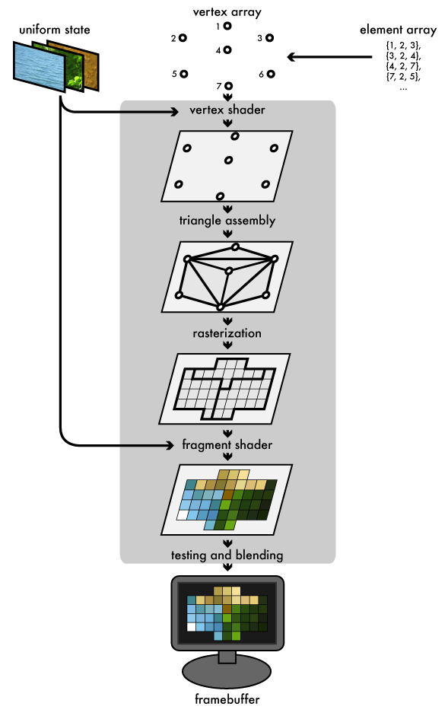
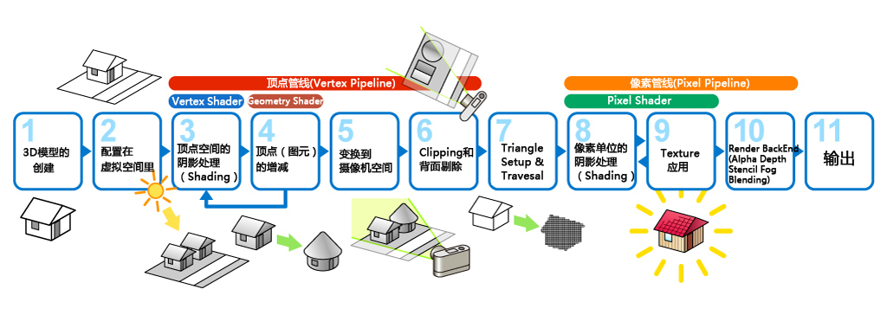
Starling - Graphics Pipeline

Slide 14
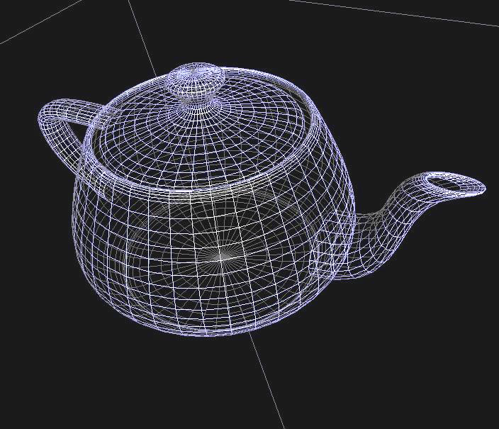
Starling - Graphics Pipeline
Vertex.
Model ->View->Project Transform

Slide 15
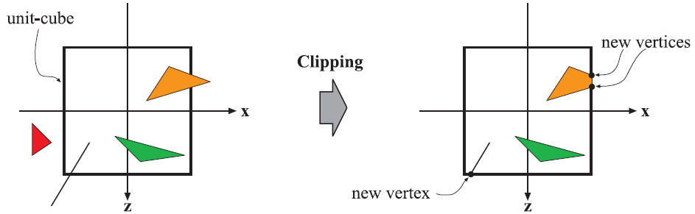
Starling - Graphics Pipeline
Vertex.
Model ->View->Project Transform

Slide 16
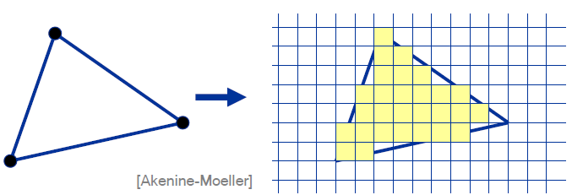
Starling - Graphics Pipeline
Vertex.
Model ->View->Project Transform

Slide 17
Starling–Framework code quick view (Code)
Codes in Starling.

Slide 18
?

Slide 19

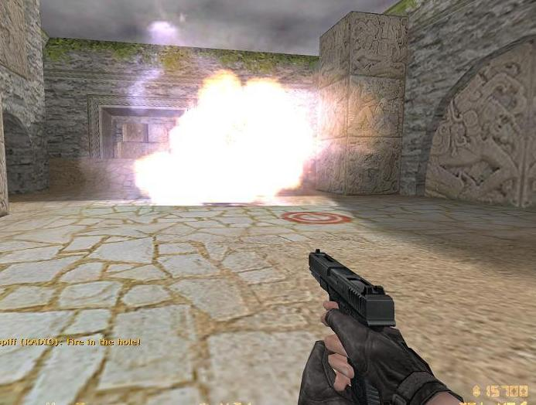
Starling-3D/2D Effect
Billboard(广告牌/公告板)

Slide 20
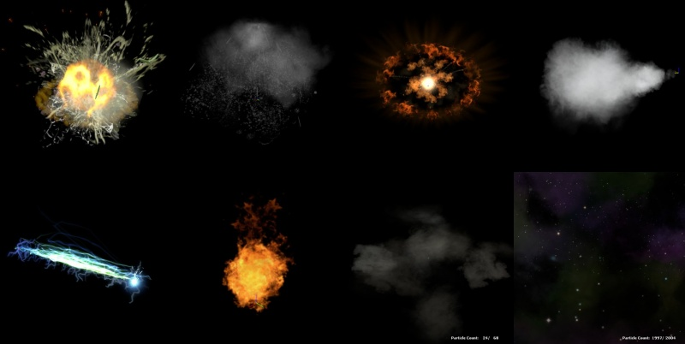
Starling-3D/2D Effect
Particle System

Slide 21
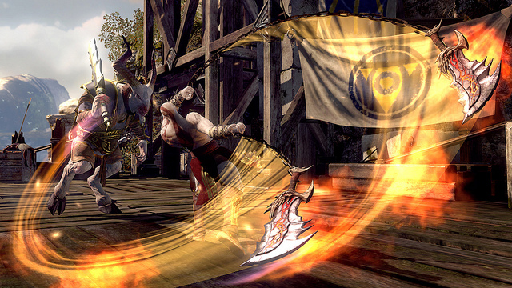
Starling-3D/2D Effect
Weapon Trail(Demo in Starling)
Demo: http://wiki.starling-framework.org/extensions/ribbontrail

Slide 22
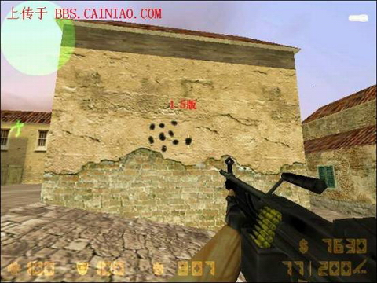
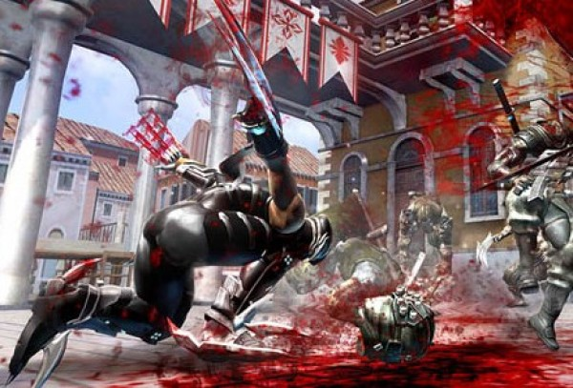
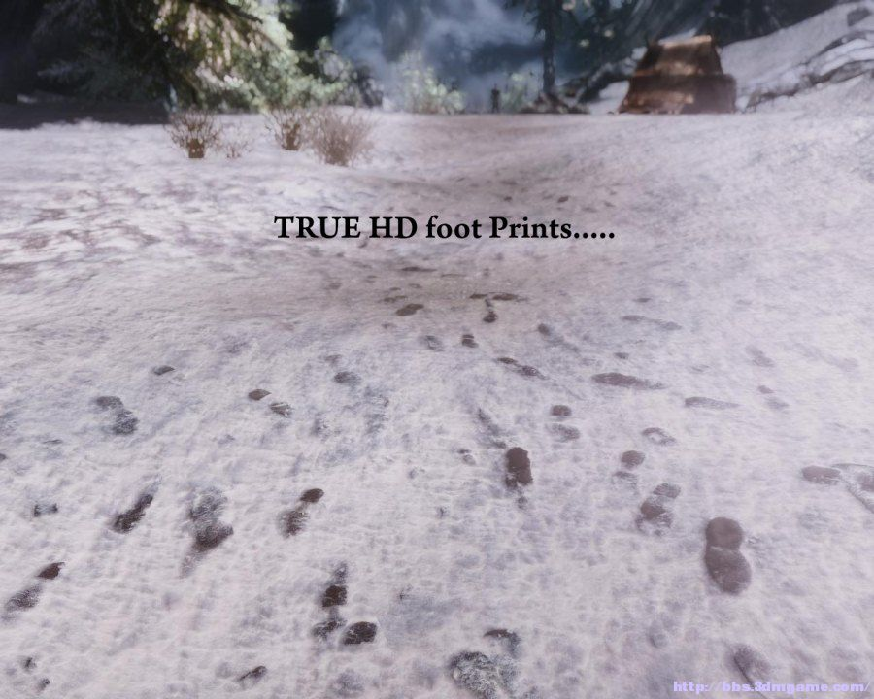
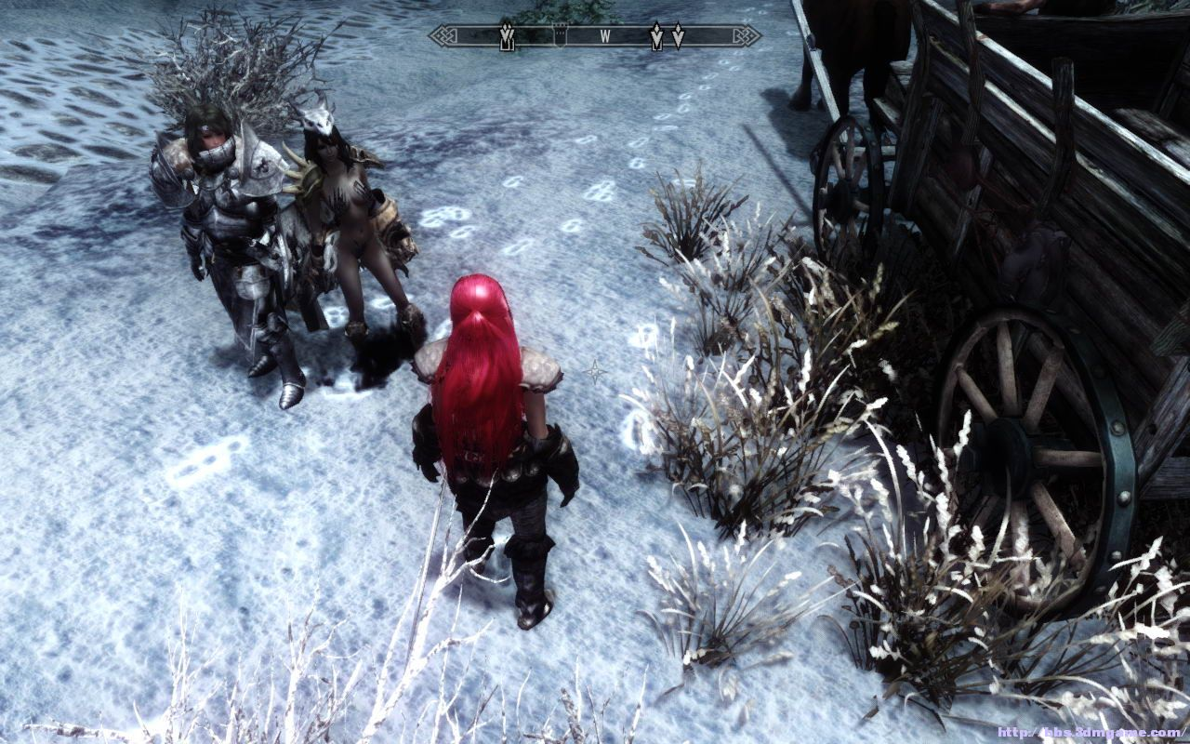
Starling-3D/2D Effect
Applique （贴花）

Slide 23
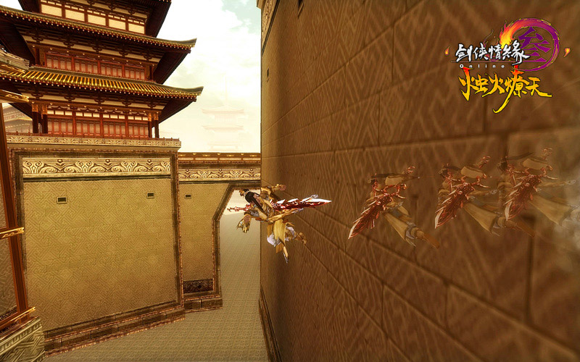
Starling-3D/2D Effect
残影/分身

Slide 24
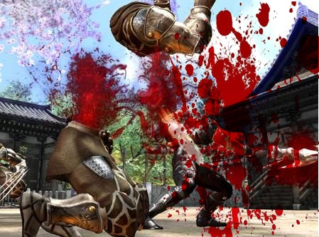
Starling-3D/2D Effect
Screen Effect (屏幕特效)

Slide 25
Starling-3D/2D Effect
http://chaimzane.iteye.com/admin/blogs/1868401

Slide 26
?

Slide 27
Entity-Component System

Slide 28
?

Slide 29
Engine Introduction

Slide 30
2D Scene(why 2d?).
Starling based.
Entity-Component architecture.
Rapid application development.

Slide 31
Links：
http://gaming.adobe.com
http://chaimzane.iteye.com/blog/1868401
http://duriansoftware.com/joe/An-intro-to-modern-OpenGL.-Chapter-1:-The-Graphics-Pipeline.html

Slide 32
END

